Slide 1
Customer Churn Analysis
Team Members:
2010030168- Tahseen Begum
2010030046- E.Pravallika
2010030550- K.Kavya
2010030362- Rushitha

Slide 2

Table Of Contents
Introduction
Literature Survey
Hardware &
Software requirements
Dataset
Data Cleaning
Data Processing
Model Selection
Algorithm
Result
Charts / Graphs
Sample Code
Conclusion
Future Scope
References

Slide 3
Introduction
Customer churn analysis is the process of identifying customers who are likely to leave a business.
It involves analyzing customer behavior, demographics, and other data to understand why customers leave and what factors contribute to their decision.
The goal of churn analysis is to develop strategies to reduce customer churn and retain more customers.
Businesses can use churn analysis to improve customer satisfaction, increase revenue, and maintain a competitive edge in the market.
Advanced machine learning and artificial intelligence techniques are commonly used in customer churn analysis to predict and prevent churn.
Identify the factors contributing to customer churn and develop a predictive model that can forecast future churn events. Provide insights to help businesses take preventive measures and retain customers, ultimately leading to higher revenue and market share.

Slide 4
Literature Survey
Title | Author | About
A Survey On Data Mining Techniques In Customer Churn Analysis For Telecom Industry | Amal M. Almana, Date:6, May 2020 | This survey focuses on data mining techniques utilized for customer churn analysis in the telecom industry. The survey investigates the most commonly used data mining techniques for customer churn analysis, such as decision trees, logistic regression, and artificial neural networks. The survey also examines the effectiveness of these techniques in predicting customer churn and retaining customers. The study sheds light on the importance of customer churn analysis and the role of data mining in enabling telecom companies to understand their customers better and develop effective retention strategies. The survey concludes with recommendations for future research in this area.

Slide 5
Literature Survey
Title | Author | About
Mobile Phone Data: A Survey of Techniques, Features, and Applications | Mohammed Okmi, Lip Yee Por, Tan Fong Ang and Chin Soon Ku | The results also show that classification and clustering approaches have been widely used where algorithms such as SVM and k-means are used to classify or cluster human activities based on their calling or mobility features. The results show that the spatiotemporal calling feature has been widely used to depict human behaviors. This feature allows for the estimation of hourly dynamic population, the classification of land use, the estimation of ambient population, the investigation of the relationship between human dynamics and crime spatial–temporal patterns, defining the actual populations at risk, and others.

Slide 6
Literature Survey
Title | Author | About
Analysis of customer churn prediction in the telecom industry using decision trees and logistic regression | lonu܊ Brându܈oiu, Gavril Toderean, Horia | we describe the principal component analysis (PCA) technique that we apply to the dataset. In we present the architectures of the three machine learning algorithms used for classification, i.e. to predict the state of the Churn variable based on the independent variables. These algorithms are neural networks, support vector machines (SVM), and Bayesian networks (BN). the models have a very good performance of 99% to 100% in predicting churners in a mobile telecommunications company. Decision making employees can build different marketing approaches to retain churners based on the predictors that have higher importance in scoring the model performance.

Slide 7
Hardware and Software Requirements
SOFTWARE REQUIREMENTS:
The major software requirements of the project are as follows:
Language: Python
Operating system: Windows XP
Tools: Google Colab
HARDWARE REQUIREMENTS:
The hardware requirements that map to the software are as follows:
RAM: 8.00 GB (7.87 GB usable)
Processor: Intel(R) Core (TM) i5-10300H CPU @ 2.50GHz 2.50 GHz
System type: 64-bit operating system, x64-based processor
Version: 20H2
Edition: Windows 10 Home Single Language

Slide 8
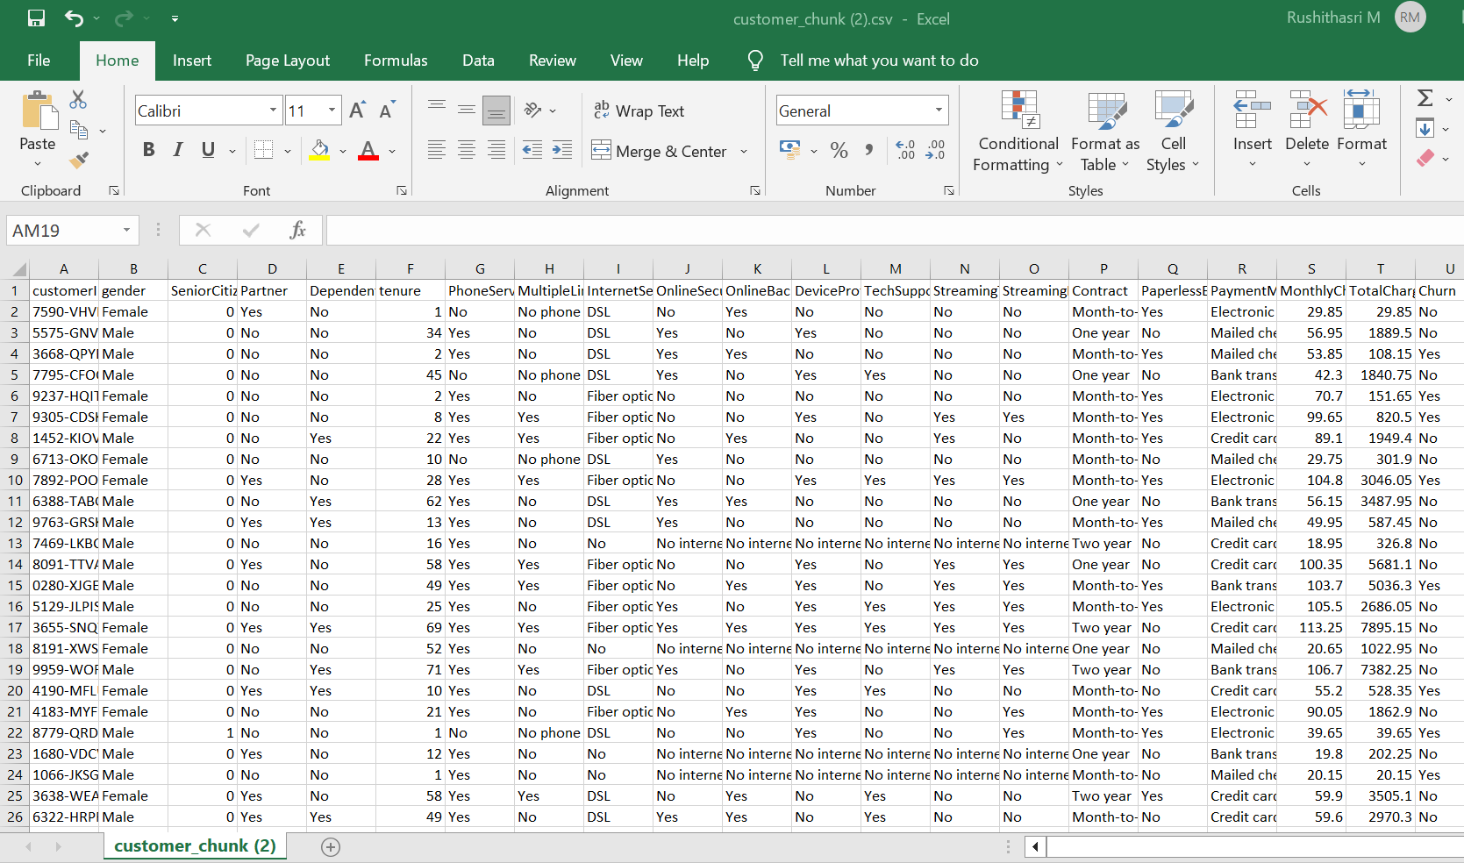
Dataset

Slide 9
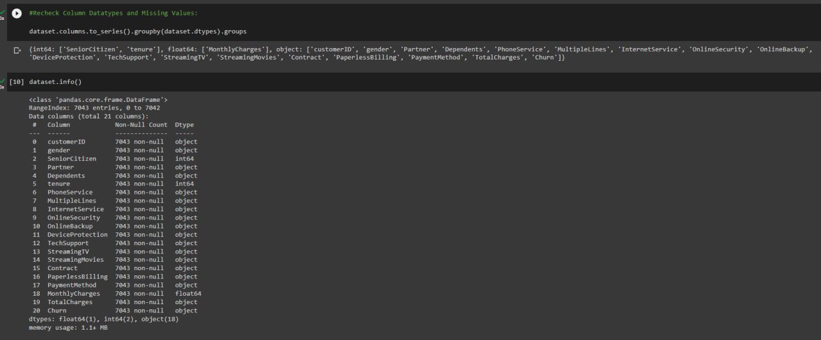
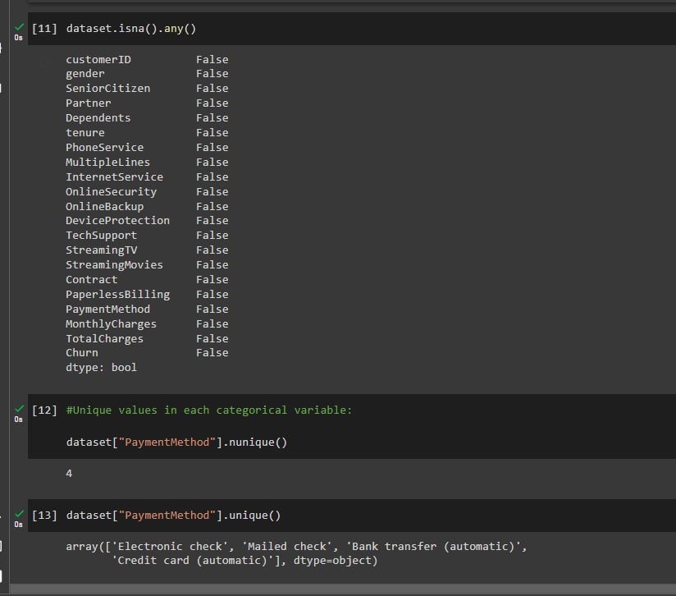
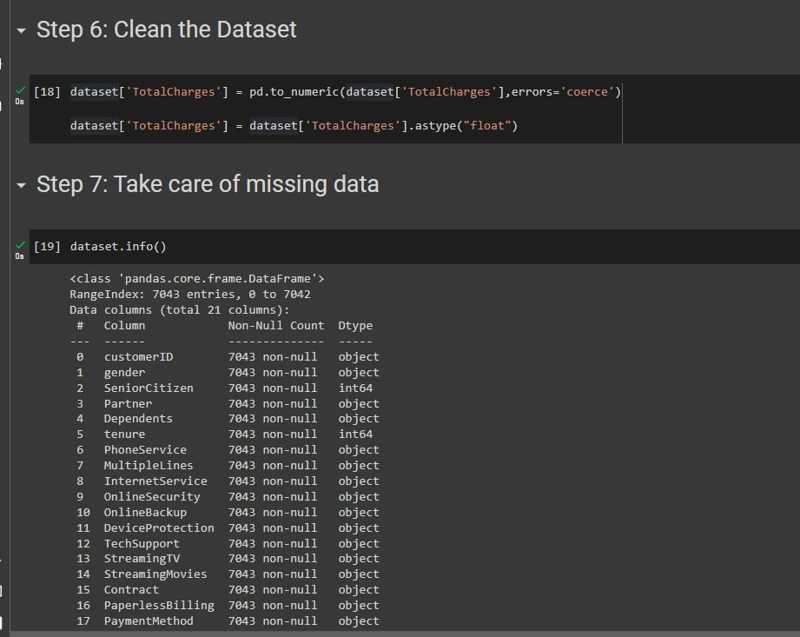
Data Cleaning

Slide 10
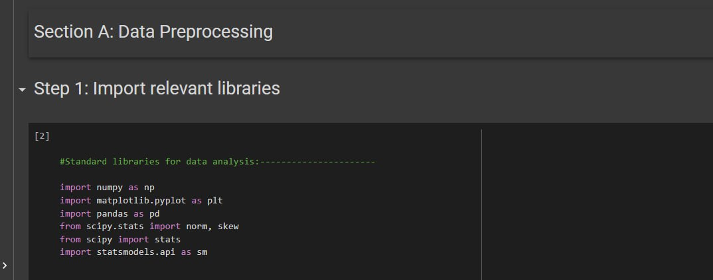
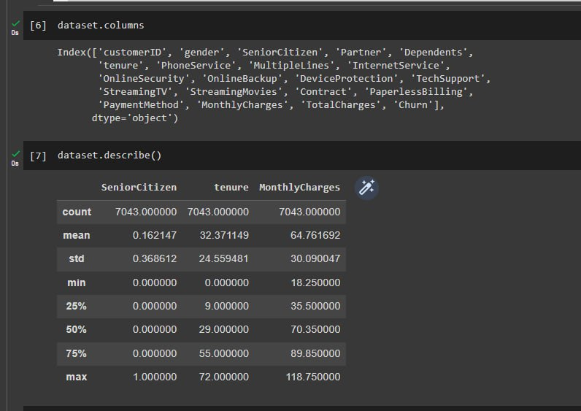
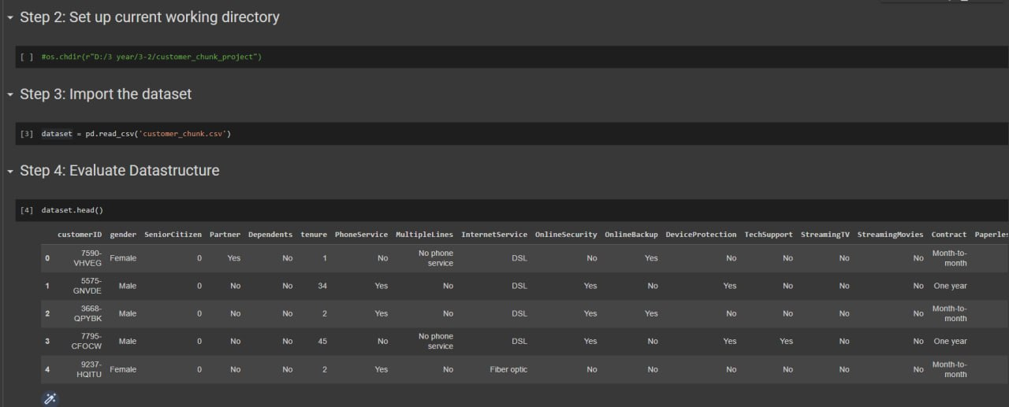
Data Processing

Slide 11
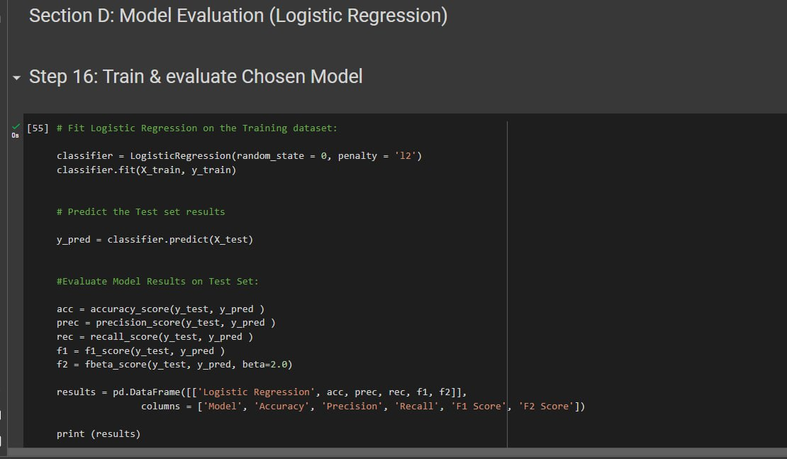
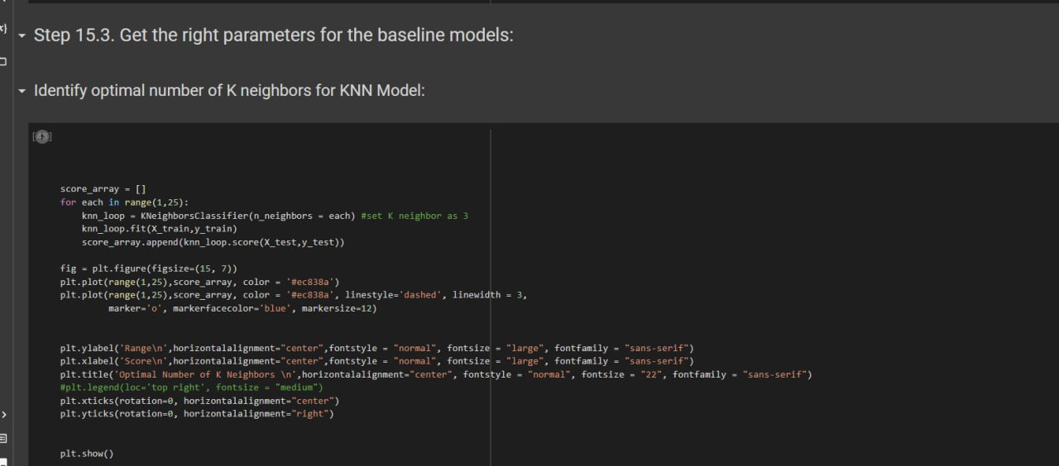
Model Selection

Slide 12
Algorithm
Logistic regression is a statistical technique that can be used to evaluate the performance of predictive models and also to predict the outcome of a binary event.
It is often used in classification tasks, where it can be used to identify relationships between independent variables and a target variable.
It uses an equation to calculate the probability that an event will occur, given certain independent variables.
By analyzing the data, logistic regression can help identify patterns and trends that can be used to make predictions about future events.
To evaluate the performance of a logistic regression model, one must consider several factors such as accuracy, precision, recall, and other metrics.

Slide 13
Result
Customer churn analysis is the process of identifying customers who are likely to discontinue their relationship with a business. This can be done by analyzing customer data such as purchase history, demographic information, and engagement metrics. The goal is to understand why customers are leaving and take proactive measures to prevent churn. This can include targeted marketing campaigns, improving customer service, or enhancing product features. By reducing customer churn, businesses can increase customer loyalty and revenue.

Slide 14
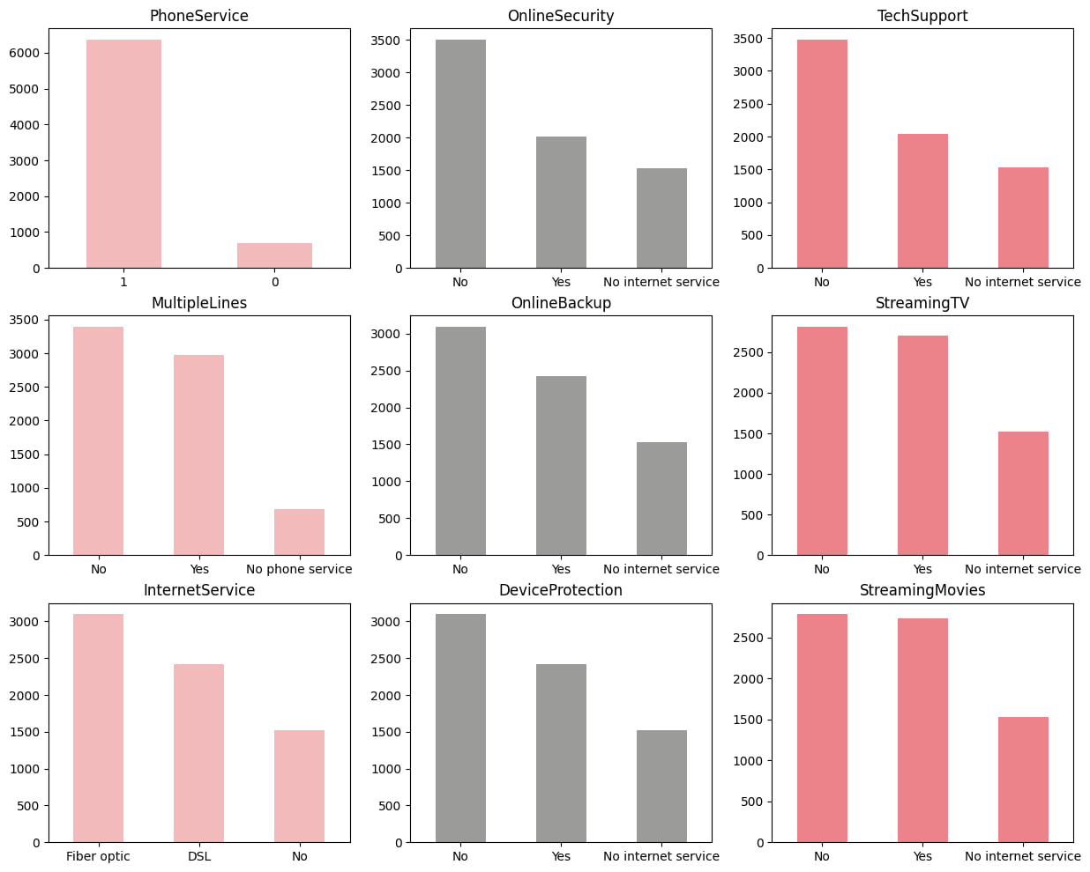
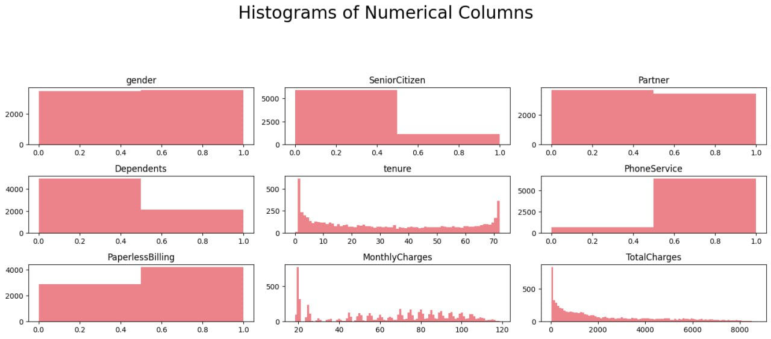
Charts / Graphs
Categorical variables

Slide 15
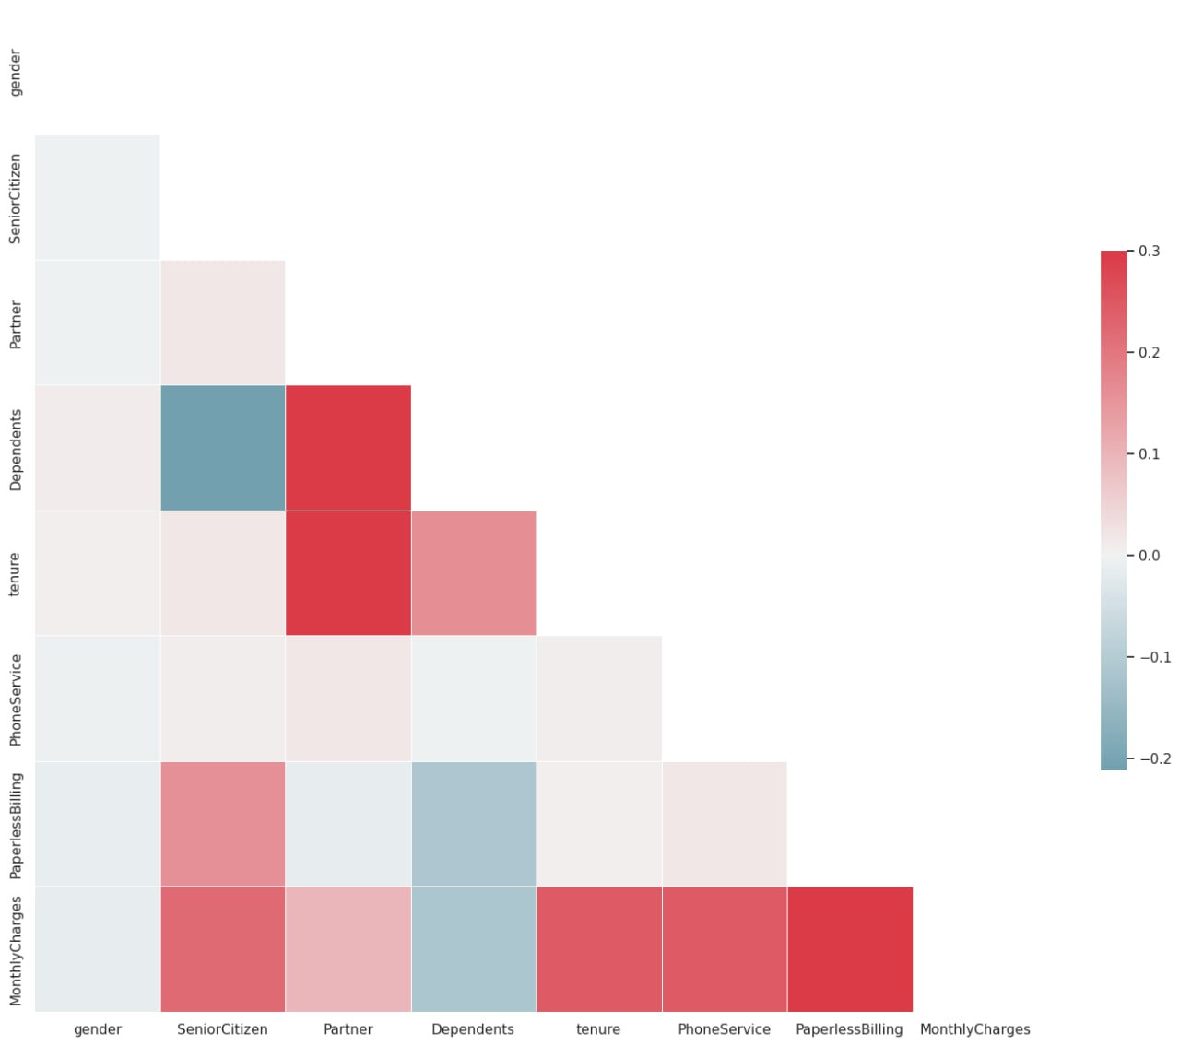
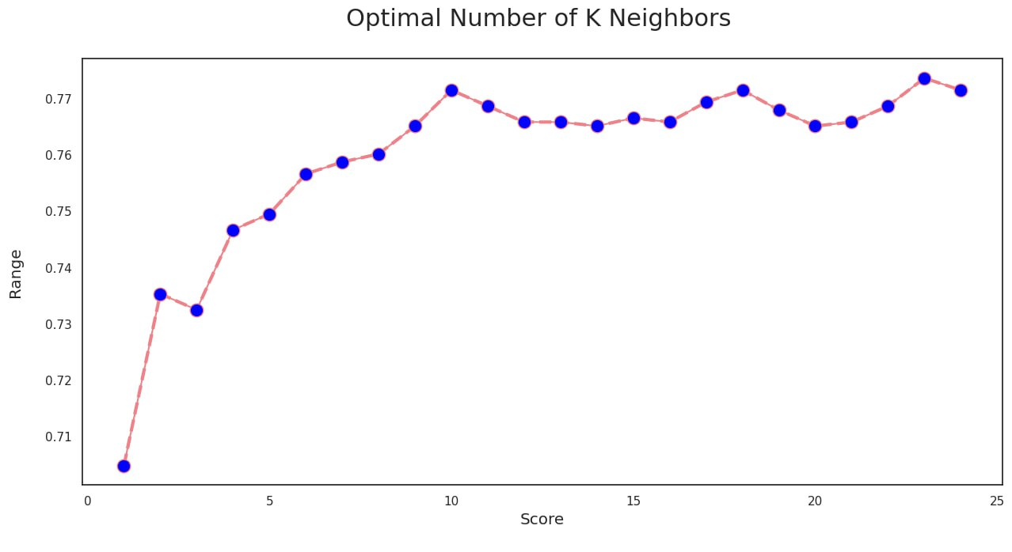
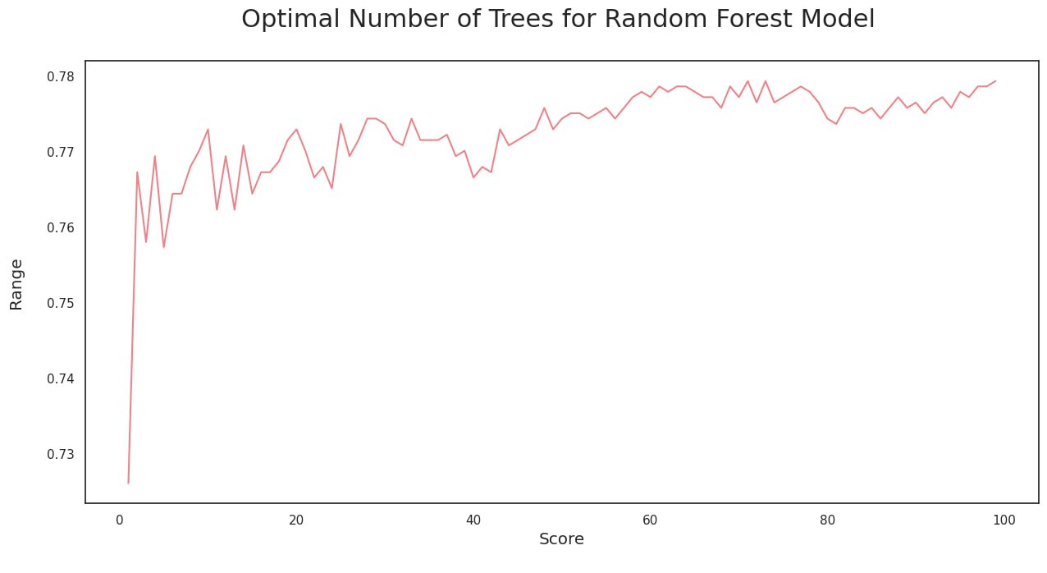
Correlation matrix of all independent variables

Slide 16
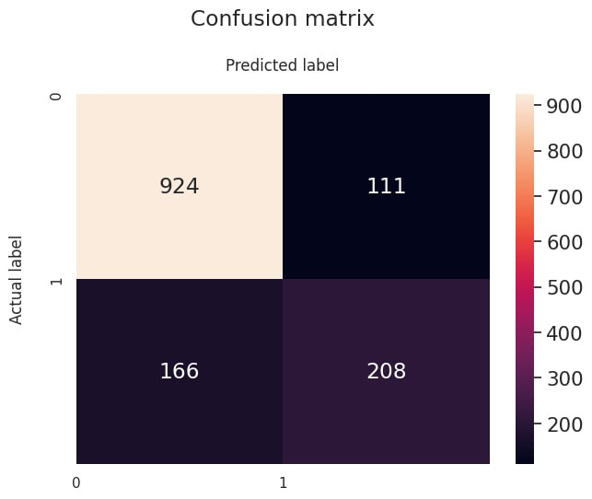
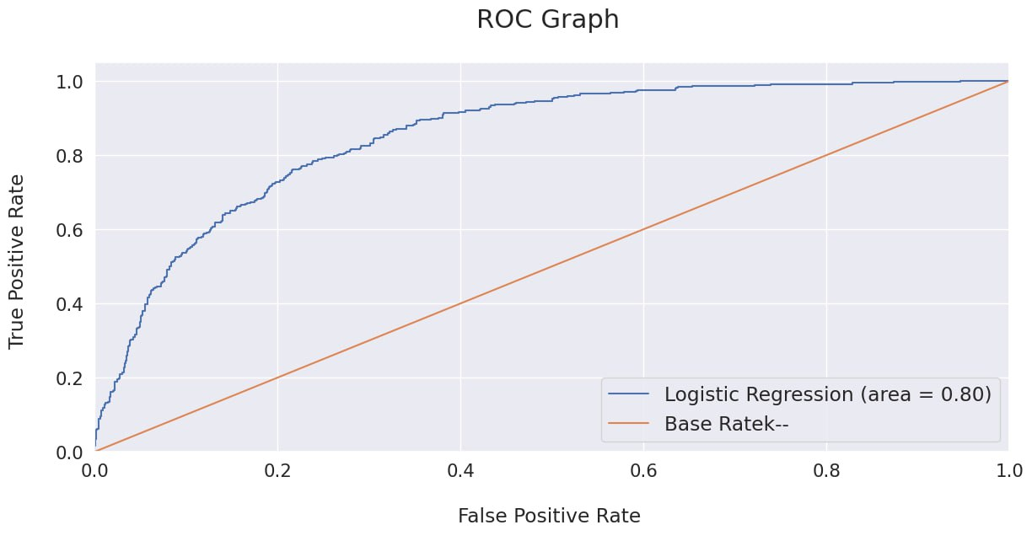
Graphs ->r oc using true +ve rate and false +ve rate
Result logistic regression confusion matrix

Slide 17
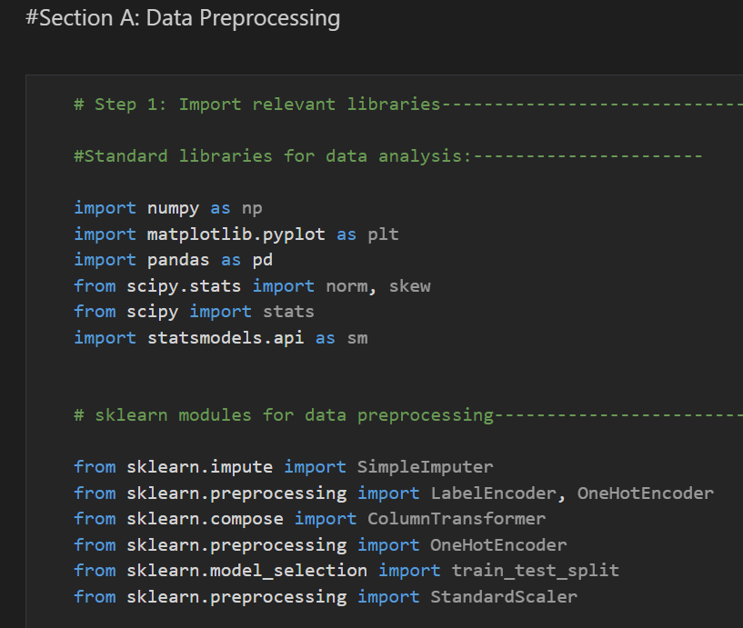
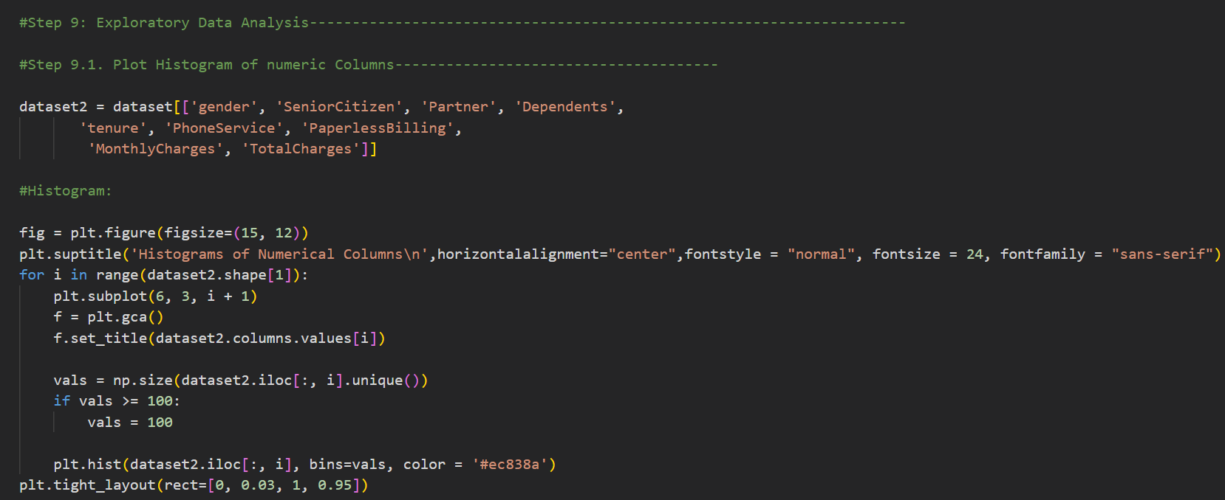

Sample Code

Slide 18

Conclusion
Collect data from telecom to conduct customer churn analysis here we will use data analytics tools to extract insights from the data. Create visual representations of the data through graphs and charts. Develop strategies to address the underlying issues and reduce churn. Present the findings and recommendations through a website.

Slide 19

Future Scope
The future outlook for customer churn analysis looks promising as companies are becoming increasingly aware of the importance of this process. With the help of AI-driven solutions, businesses can gain insights into customer behavior and use these insights to develop strategies that can reduce churn rates in the long run. Additionally, predictive analytics tools can be used to identify high-risk customers before they decide to leave, allowing companies to intervene at an earlier stage.

Slide 20

References
Almana, Amal M., Mehmet Sabih Aksoy, and Rasheed Alzahrani. "A survey on data mining techniques in customer churn analysis for telecom industry." International Journal of Engineering Research and Applications 4, no. 5 (2014): 165-171.
Okmi, Mohammed, Lip Yee Por, Tan Fong Ang, and Chin Soon Ku. "Mobile Phone Data: A Survey of Techniques, Features, and Applications." Sensors 23, no. 2 (2023): 908.
Dalvi, Preeti K., Siddhi K. Khandge, Ashish Deomore, Aditya Bankar, and V. A. Kanade. "Analysis of customer churn prediction in telecom industry using decision trees and logistic regression." In 2016 symposium on colossal data analysis and networking (CDAN), pp. 1-4. IEEE, 2016.

Slide 21
Thank you

